Slide 1
The Activity Selection
An optimization problem which deals with the selection of non-conflicting activities that needs to be executed by a single person or machine in a given time frame.
Each activity is marked by a start and finish time. Greedy technique is used for finding the solution since this is an optimization problem.

Slide 2
Let's consider that you have n activities with their start and finish times,
The objective is to find solution set having maximum number of non-conflicting activities ,
can be executed in a single time frame,
Assuming that only one person or machine is available for execution.

Slide 3
It might not be possible to complete all the activities, since their timings can collapse.
Two activities, say i and j, are said to be non-conflicting if si >= fj or sj >= fi where si and sj denote the starting time of activities i and j respectively, and fi and fj refer to the finishing time of the activities i and j respectively.
Greedy approach can be used to find the solution since we want to maximize the count of activities that can be executed. This approach will greedily choose an activity with earliest finish time at every step, thus yielding an optimal solution.

Slide 4
Input Data for the Algorithm:
act[] array containing all the activities.
s[] array containing the starting time of all the activities.
f[] array containing the finishing time of all the activities.
Output Data from the Algorithm:
sol[] array referring to the solution set containing the maximum number of non-conflicting activities.

Slide 5
Steps for Activity Selection Problem
Following are the steps we will be following to solve the activity selection problem,
Step 1: Sort the given activities in ascending order according to their finishing time.
Step 2: Select the first activity from sorted array act[] and add it to sol[] array.
Step 3: Repeat steps 4 and 5 for the remaining activities in act[].
Step 4: If the start time of the currently selected activity is greater than or equal to the finish time of previously selected activity, then add it to the sol[] array.
Step 5: Select the next activity in act[] array.
Step 6: Print the sol[] array.

Slide 6
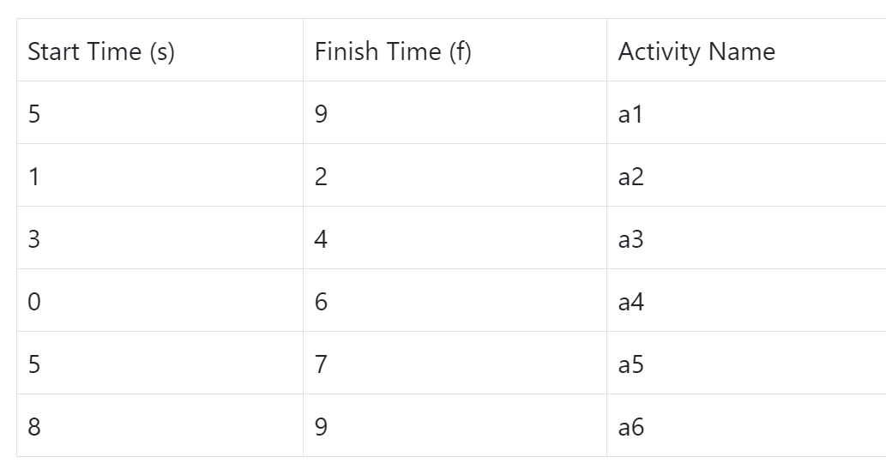

Slide 7
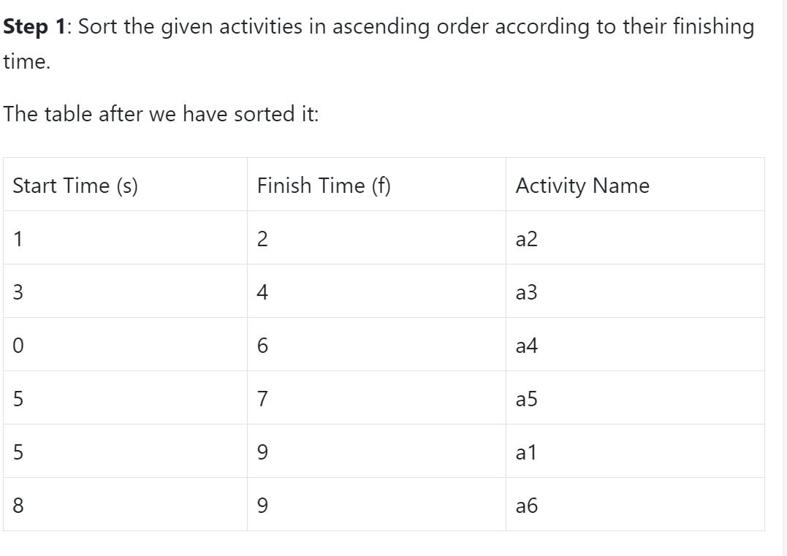

Slide 8
Step 2: Select the first activity from sorted array act[] and add it to the sol[] array, thus sol = {a2}.
Step 3: Repeat the steps 4 and 5 for the remaining activities in act[].
Step 4: If the start time of the currently selected activity is greater than or equal to the finish time of the previously selected activity, then add it to sol[].
Step 5: Select the next activity in act[]

Slide 9
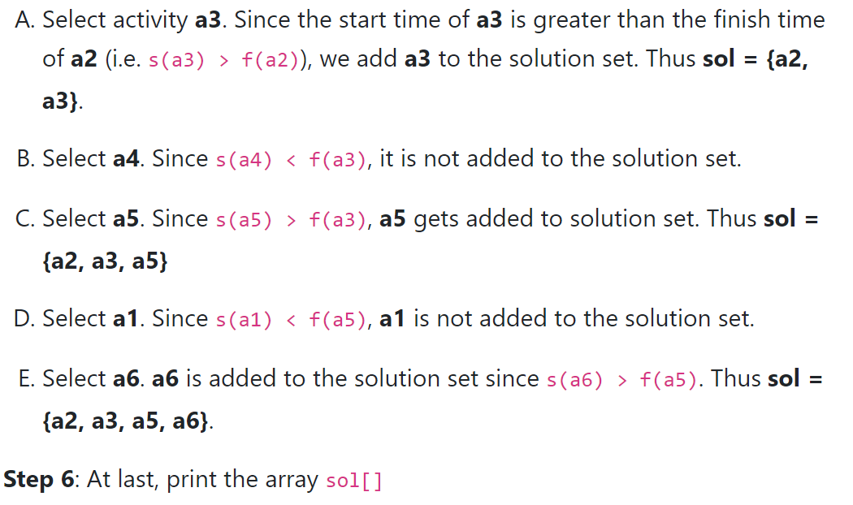

Slide 10
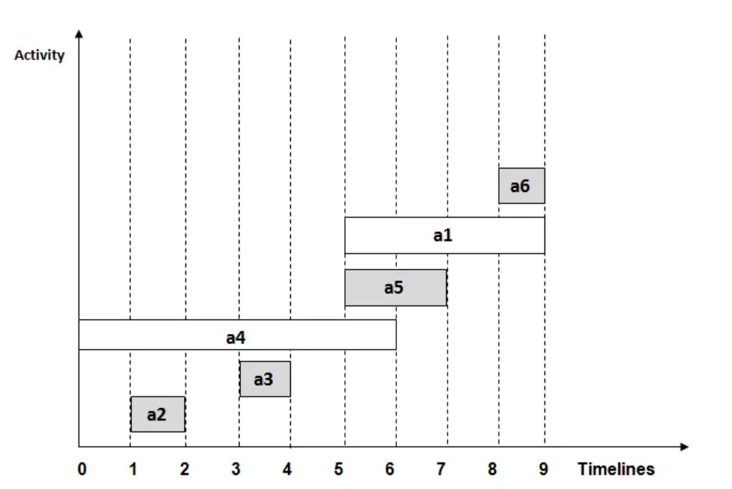

Slide 11
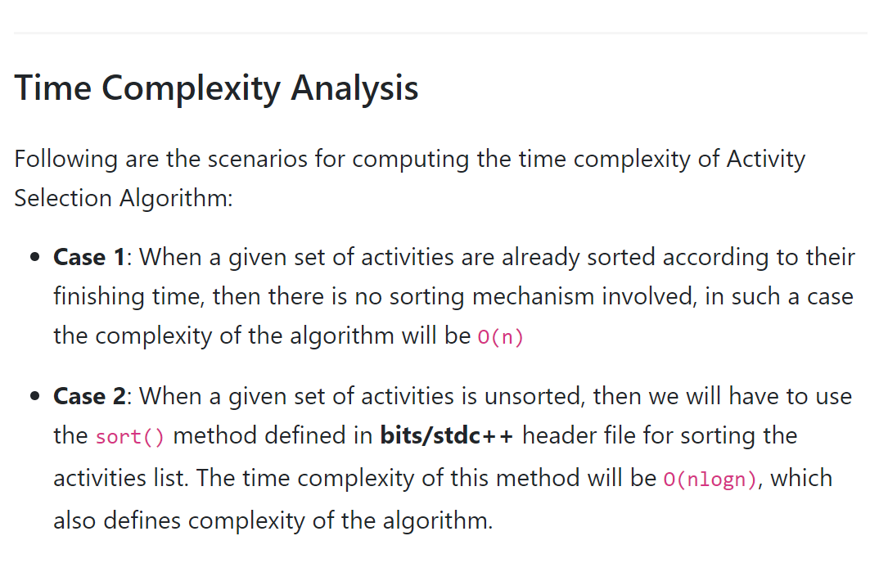

Slide 12
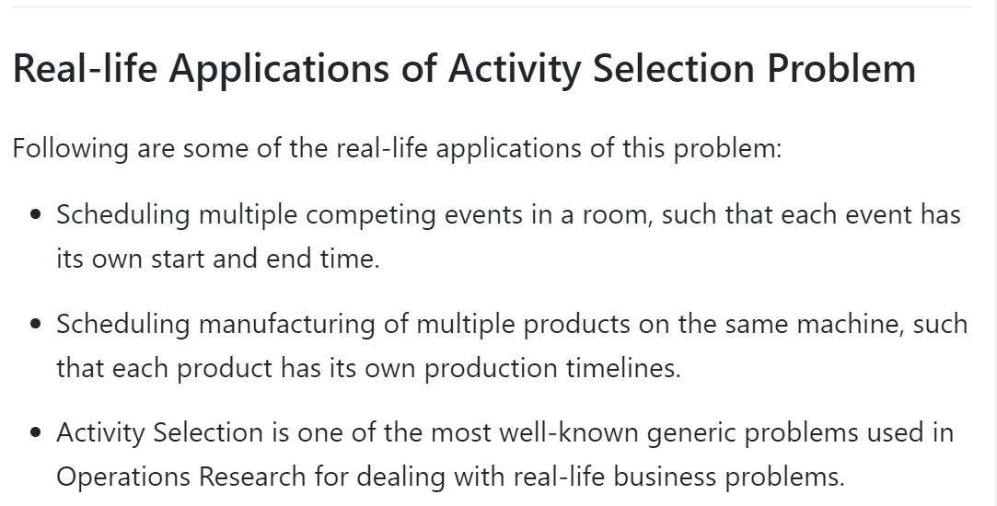

Slide 13
#include <bits/stdc++.h>
using namespace std;
#define N 6 // defines the number of activities
// Structure represents an activity having start time and finish time.
struct Activity {
int start, finish; };
// This function is used for sorting activities according to finish time
bool Sort_activity(Activity s1, Activity s2)
{ return (s1.finish< s2.finish); }
/* Prints maximum number of activities that can
be done by a single person or single machine at a time.
*/
void print_Max_Activities(Activity arr[], int n)
{
// Sort activities according to finish time
sort(arr, arr+n, Sort_activity);
cout<< "Following activities are selected \n";
// Select the first activity
int i = 0;
cout<< "(" <<arr[i].start<< ", " <<arr[i].finish << ")\n";

Slide 14
// Consider the remaining activities from 1 to n-1
for (int j = 1; j < n; j++)
{
// Select this activity if it has start time greater than or equal to the finish time of previously selected activity
if (arr[j].start>= arr[i].finish)
{
cout<< "(" <<arr[j].start<< ", "<<arr[j].finish << ") \n";
i = j; }
}
}
// Driver program
int main()
{
Activity arr[N];
for(int i=0; i<=N-1; i++)
{
cout<<"Enter the start and end time of "<<i+1<<" activity \n";
cin>>arr[i].start>>arr[i].finish;
}
print_Max_Activities(arr, N);
return 0;
}

